Slide 1



Treat Thyself
Philotreat
UNCOMFORTABLE QUESTIONS CLUB

Slide 2

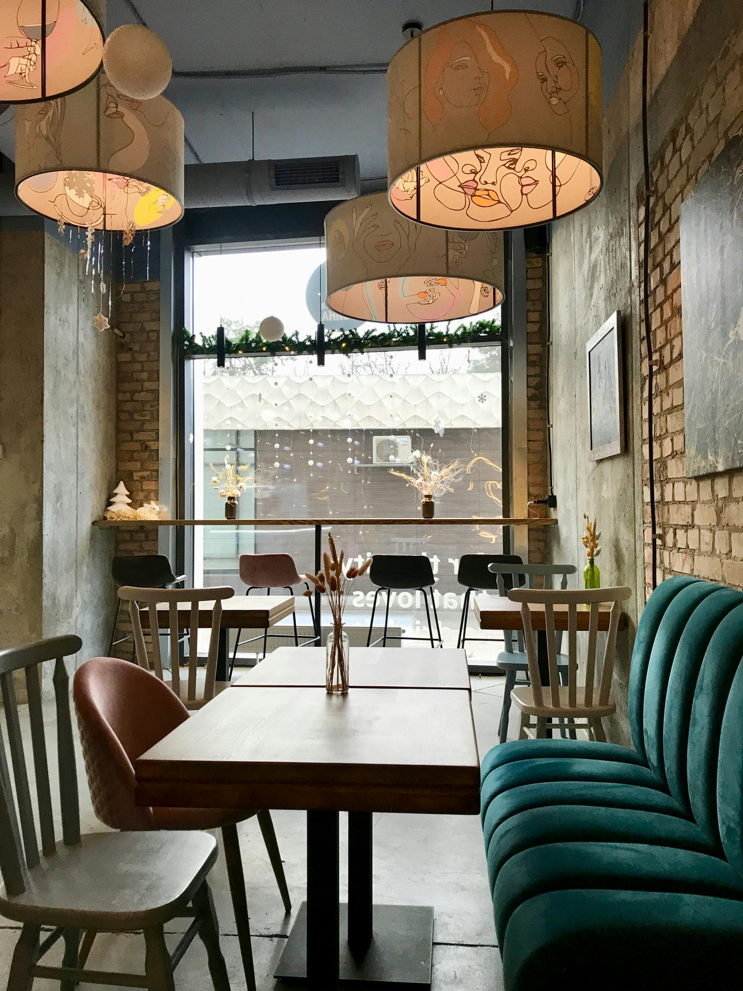

www.philotreat.com
About Us
Philotreat is a space for people who think deeply, feel quietly, and seek clarity without noise.
This is not self-help.
This is not motivation.
This is Inquiry + Inner Work.
We gather online to reflect on everyday inner struggles—without fixing, preaching, or rushing toward answers. Instead, we explore questions that matter through philosophy, lived experience, and calm dialogue.
100%
Free

Slide 3
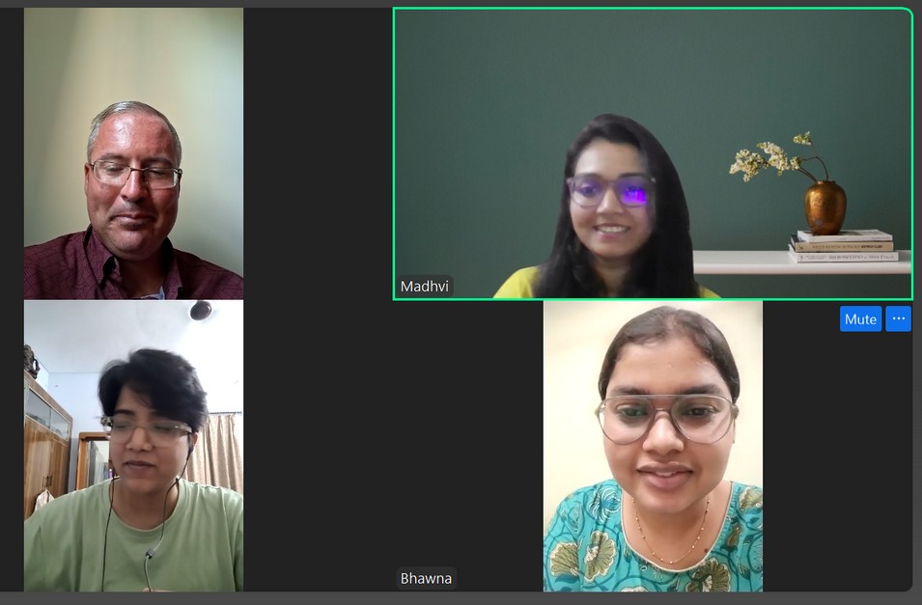
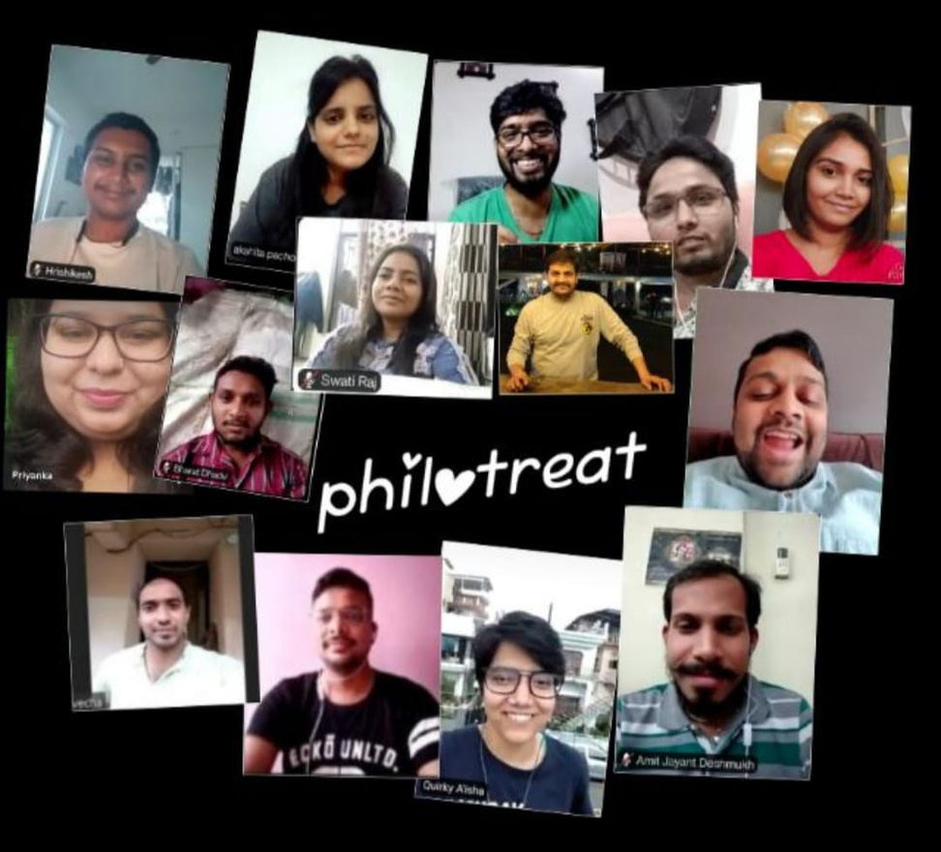
Community Members
www.philotreat.com
Dr. Madhvi Prasad- Assistant Professor, Philosophy & Spiritual Studies
Prof. (Dr.) Daniel Del Monte- Philosophy Professor, United States
Dimitris Rinis- English Language Teacher, Educator
Aisha- Most active Research Scholar, University of Delhi
Bhawna Singh- Research Scholar, SSPIS Goa University
Saima Hasan- Research Scholar, Aligarh Muslim University
Dr. Nishant Singh- Assistant Professor, Buddhist Studies

Slide 4
Speaker Guest
www.philotreat.com
DIMITRIS RINIS is an Educator, an English Language and Literature teacher, an adult education trainer with 25 years of experience in Public Secondary and Post-Secondary Education, a Researcher, Author, and Academic Writer on educational and philosophical topics. He holds a degree in English Philology from Aristotle University of Thessaloniki (AUTH), and two Postgraduate Degrees in Teaching English as a Foreign/International Language (TEFIL) and in Educational Administration and Evaluation. He has authored the Universal Philosophical Theory, which uncovers Plato's Atlantis. He is the founder of the Universal Philosophical Community, "The White Tower", U.P.C. The White Tower, since 2023, analyzing the tetraptych "Education, Philosophy, Theology, Geopolitics." The U.P.C. The White Tower community collaborates with philosophers, scientists, citizens, and organizations worldwide to investigate global issues of our era, aiming to achieve solutions that are commonly accepted and sustainable. The community's base is on LinkedIn, and its work is posted on YouTube and Substack.

Slide 5
Why are we exhausted even when nothing is “wrong”?
www.philotreat.com
Emotional Backlog
Inner Noise
UNPROCESSED STORIES, FEARS, AND UNRESOLVED MICRO-STRESSES
OUR MIND IS NEVER FULLY AT REST
Identity Incoherence
Existentical Overload
CARRYING MULTIPLE- PROFESSIONAL, PERSONAL, EMOTIONAL, SOCIAL ROLES
WHAT TO DO, WHO TO BE, HOW TO LIVE

Slide 6
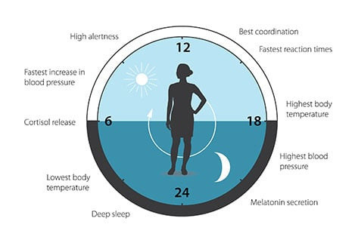
The circadian clock anticipates and adapts our physiology to the different phases of the day. Our biological clock helps to regulate sleep patterns, feeding behavior, hormone release, blood pressure, and body temperature.

Slide 7

Join Us
www.philotreat.com
  Weekly reflective sessions.
  Community for deep thinkers & seekers.
  Follow on YouTube | Instagram | Website: Philotreat

Slide 8
Philotreat
Thank
You.
www.philotreat.com

